Slide 1
The Four Types of Market Structure
Number of Firms?
Many
firms
Type of Products?
One
Few
Differentiated
Identical
firm
firms
products
products
Monopolistic
Perfect
Monopoly
Oligopoly
Competition
Competition
•
Tap water
Computers
•
Novels
•
Wheat
•
•
Electricity
•
Crude oil
•
Movies
•
Milk

Slide 2
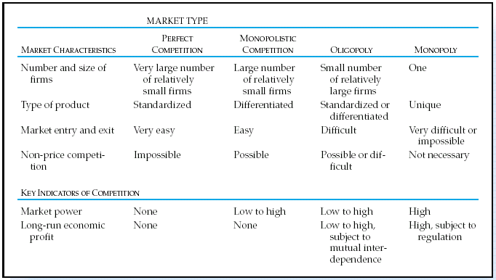

Slide 3
Perfect Competition (no market power)
Perfect competition is a theoretical market structure. It is primarily used as a benchmark against which other market structures are compared. The industry that best reflects perfect competition in real life is the agricultural industry.
  Non-price competition not possible as there is uniform price

Slide 4
Basic Assumptions
Many small firms, each of whom produces an insignificant percentage of total market output and thus exercises no control over the ruling market price.
Many individual buyers, none of whom has any control over the market price – i.e. there is no monopsony power
Perfect freedom of entry and exit from the industry. Firms face no sunk costs - entry and exit from the market is feasible in the long run. This assumption ensures all firms make normal profits in the long run.

Slide 5
Basic Assumptions
Homogeneous products are supplied to the markets that are perfect substitutes. This leads to each firm being passive “price taker” and facing a perfectly elastic demand curve for their product
Perfect knowledge – consumers have readily available information about prices and products from competing suppliers and can access this at zero cost – in other words, there are few transactions costs involved in searching for the required information about prices
Perfect Mobility: Firms can enter or leave the market.

Slide 6


Slide 7
Pricing and Output Decisions in Perfect Competition
The Basic Business Decision
The decision to continue competing in a market depends upon:
  How much to produce?
  If such an amount is produced, how much profit will be earned?
  If a loss rather than a profit is incurred, will it be worthwhile to continue in this market in the long run or should the firm exit?

Slide 8
Key Assumptions in Perfect Competition
Price taker
Distinction between short run and long run
Objective is to maximize profit or minimize loss in the short run

Slide 9
Key Assumptions in Perfect Competition
Normal profit occurs when revenue just covers all of the firm’s economic cost
Economic loss occurs when revenue fails to cover the firm’s economic cost
Economic profit occurs when revenue more than covers the firm’s economic cost

Slide 10
Key Assumptions in Perfect Competition
Marginal Revenue and Average Revenue
Since the firm receives the market price for each unit sold, and this market price does not change, the firm’s marginal revenue (MR) and average revenue (AR) curves are also horizontal at the market price.
Y
P=AR=MR
o
X

Slide 11
Selecting the Optimal Output Level
Marginal Revenue – Marginal Cost Approach
Marginal revenue is the revenue the firm receives from selling an additional unit.
Marginal cost is the cost the firm incurs by producing an additional unit.
If marginal revenue exceeds marginal cost it is worthwhile for the firm to produce and sell an additional unit

Slide 12
MR=MC Rule
  A firm that wants to maximize its profit (or minimize its loss) should produce a level of output at which the additional revenue received from the last unit is equal to the additional cost of producing that unit. In short, MR=MC.
  Applies to any firm that wishes to maximize profit.
  For the perfectly competitive firm, the rule may be restated, P=MC. Why?

Slide 13
Marginal Revenue – Marginal Cost Approach
Y
MC
AC
Graphically, find the output at which MR=MC. Label this Q*
Profit=TR – TC
=Q*•P – Q*•AC
=Q*•(P - AC)
=Rectangle DABC
T
S
P
E
O
Q*
X

Slide 14
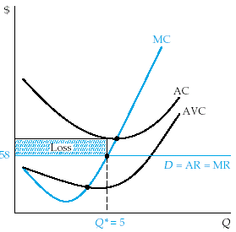
Economic Profit, Normal Profit,
Loss, and Shutdown
The firm incurs a loss. At the optimum output level price is below average cost.
However, since price is greater than average variable cost, the firm is better off producing in the short run. Why?

Slide 15
Shutdown point
The shutdown point is the lowest price at which the firm would still produce.
At the shutdown point, the price is equal to the minimum point on the AVC.
If the price falls below the shutdown point, revenues fail to cover the fixed costs and the variable costs.
The contribution margin is negative.
The firm would be better off if it shut down and just paid its fixed costs.

Slide 16
The Competitive Market in the Long Run
In the long run, the price in the competitive market will settle at the point where firms earn a normal profit.
Economic profit invites entry of new firms (why?) which shifts the supply curve to the right, puts downward pressure on price and reduces profits

Slide 17
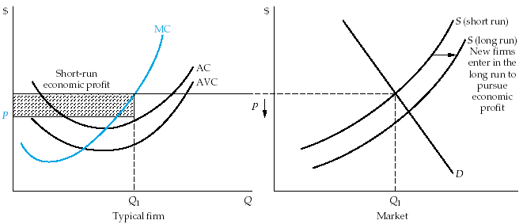
The Competitive Market in the Long Run

Slide 18
The Competitive Market in the Long Run
Economic loss encourages exit of existing firms (why?) which shifts the supply curve to the left, puts upward pressure on price and increases profits.

Slide 19
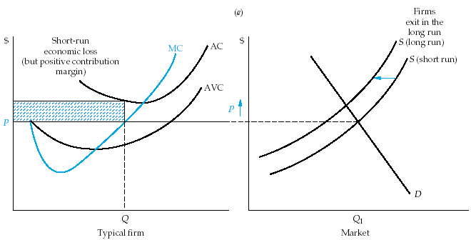
The Competitive Market in the Long Run

Slide 20
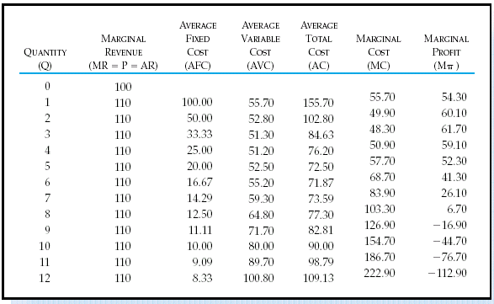
Selecting the Optimal Output Level
Marginal Revenue – Marginal Cost Approach

Slide 21
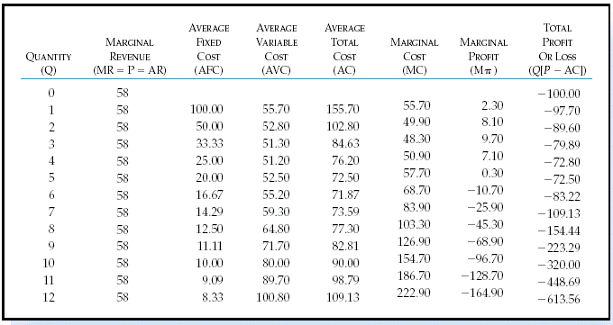

Slide 22
Perfect Competition
There are two players, Ramco and Tamco, in a market. The reaction functions of Ramco and Tamco are:
QR= 50 – 0.5QT
QT = 60 – QR
Where, QR is quantity produced by Ramco and QT is quantity produced by Tamco. If the market is transformed into a perfectly competitive market, the output for the industry would be

Slide 23
Perfect Competition
Suppose that the supply and demand equations for a perfectly competitive market are:
QD = 1625 - 50P
QS = 25 + 30P
Calculate the market-equilibrium price and quantity.
Suppose that there are 25 firms in the industry. How much does each firm in the industry produce?
Suppose that the total cost equation of each firm in the industry is TC = 5 + 10Q + 0.2Q².
Is each firm producing at its profit maximizing level of output?
If not, when how should each firm alter its production?
Is each firm in the industry in long-run competitive equilibrium?

